Slide 1
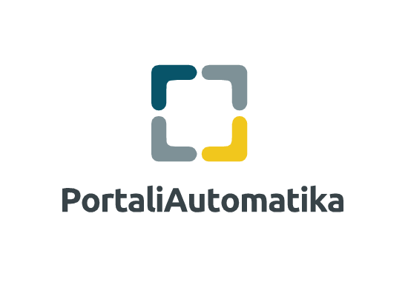
PORTAL LICENSE

Slide 2











OVERVIEW
Enterprise Portal Software is an enterprise web platform for building business solutions that deliver immediate results and long-term value.
Simplified UI Development
Rules Engine Integration
Flexible Enterprise Integration Framework
SOA Framework
Out-of-the-box Tools
User Personalization
Secure Single Sign On (SSO)
Role Based Content Delivery
Custom Fields
Auditing & Performance Monitoring
Working from Your Desktop with Sync

Slide 3
SOLUTION
Single Sign-On
Customization
enterprise portals can provide single sign-on capabilities between their users and various other systems. This requires a user to authenticate only once.
Users can customize the look and feel of their environment. Customers who are using EIPs can edit and design their own web sites which are full of their own personality and own style; they can also choose the specific content and services they prefer. Also refers to the ability to prioritize most appropriate content based on attributes of the user and metadata of the available content. Can work both the Portal and your desktop becomes a seamless experience.
Enterprise Integration Framework
the connection of functions and data from multiple systems into new components/portlets/web parts with an integrated navigation between these components. Included multiple methods to integrate with external content and data.

Slide 4
Personalization
CMS and Collaboration Engine
Personalization is more about matching content with the user. Based on a user profile, personalization uses rules to match the "services", or content, to the specific user. To some degree, you can think of the two like this: customization is in hands of the end user, personalization is not. Of course actual personalization is often based on your role or job function within the portal context. User attributes are editable by Administrator..
the integration of content provided by other portals, typically through the use of WSRP or similar technologies.
Access Control
the ability for portal to limit specific types of content and services users have access. This access rights may be provided by a portal administrator or by a provisioning process. Access control lists manage the mapping between portal content and services over the portal user base. Portal’s performance monitoring by Administrator for better optimize resources.

Slide 5
FEATURES
Web-publishing
Web Content Structures and Templates
Unified Documents & Media
User-Driven Workflow & Approval
Documents can be uploaded and stored
in one file format
Drag-and-Drop Site Maps
User Defined Content Categories
Search Engine Optimization (SEO)
Asset Publisher
Multi-Language Support
Workspace Publishing
Workflow & Approval Process Driven
by the User
Easy Rich Text Editors
Staging and Easy Website Planning

Slide 6
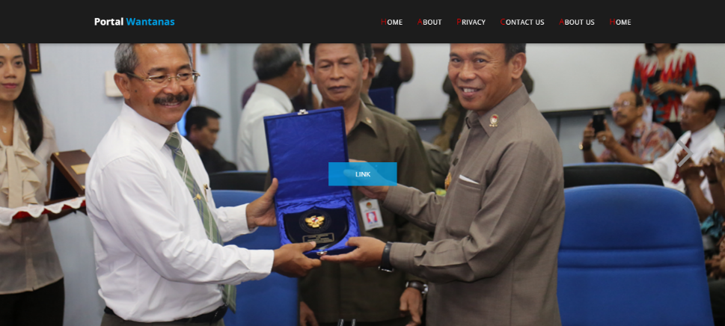
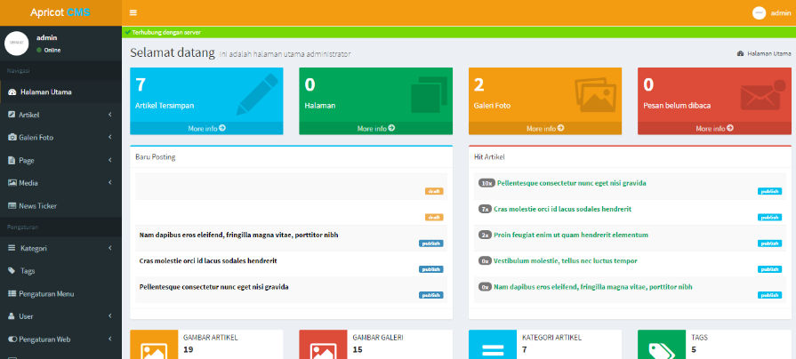
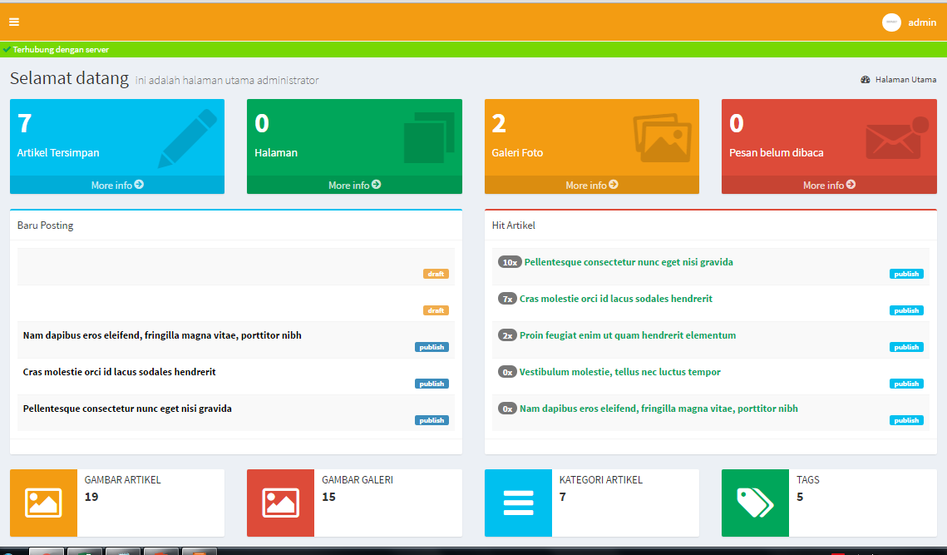
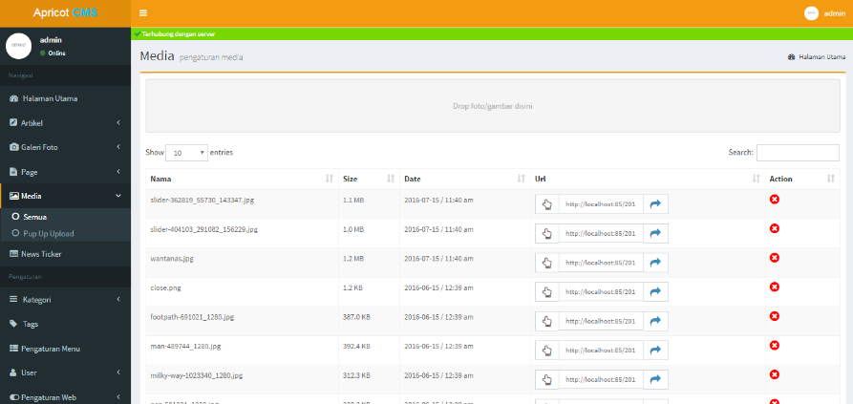
FEATURES

